Slide 1

METHODOLOGIES AND TECHNIQUES TO TEACH NEW CURRICULUM IN LOWER SECONDARY SCHOOL IN ENTREPRENEURSHIP.
BUDDO SECONDARY SCHOOL.
Facilitators
Tonny Sekamatte
Kimuli Fred
Jaggwe Ronald.

Slide 2
TEACHING AND LEARNING METHODOLOGIES
Teaching-learning methodology is a systematic way in which a teacher/facilitator transfers, receives or shares information with learners.
It can also be defined as the process of imparting knowledge and skills which is used by a teacher in the classroom. It implies the use of principles and theories of instructions; it can include class participation, demonstrations, recitation, discussion, etc.
A learner-centred methodology is one in which the learners are more active than the instructor and vice versa.
Your choice of teaching method depends on what fits you — your educational philosophy, classroom demographic, subject area(s) and school mission statement.

Slide 3

Discussion method
The discussion method provides an opportunity to monitor learning. The answers provided by learners and the questions they ask, reveal the extent and quality of learning taking place.
Facilitators can use this information to repeat or modify an explanation to improve learning.
They can also provide feedback to trainees, thereby helping to reinforce learning that has taken place.

Slide 4

CASE STUDIES
This is a teaching technique where learners are given information about a situation and they have to come to decisions or solutions to a problem concerning the situation.
assigned scenarios based on situations in which students observe, analyze, record, implement, conclude, summarize, or recommend. Case studies are created and used as a tool for analysis and discussion.
The cases given should be as close to reality as possible

Slide 5

BRAINSTORMING FOR STUDENTS
The purpose of a brainstorming session is to discover new ideas and responses very quickly.
Brainstorming allows students to think critically about ideas and solutions, form connections, and share ideas with peers. Often, there are no wrong answers when brainstorming; in this way, students are able to freely express their thoughts without fear of failure.
It is particularly a good way of getting bright ideas. It differs from the buzz group discussion in that the focus is on generating as many ideas as possible without judging them.

Slide 6

BUZZ A very short discussion on a narrow topic that involves simultaneous small group work (usually in pairs) and stimulates contribution from each member of the participant group.
Assign a topic for the groups to discuss. You could have all the groups consider the same idea, or have each group consider a different aspect of the same problem.
Have each group appoint someone to write down the group’s ideas and make sure that all have a chance to express their views.
Tell the groups they will have three or so minutes to discuss their ideas and come to some conclusions.
At the end of the time, call for reports and questions.
Have them listen to each group’s ideas and discuss them briefly.

Slide 7

Projects based on Research
The learning activities based on the research in any projects provide the opportunities to students to work on the problems that are faced in the real business world. The teachers who are efficient make the project that is relevant to the world outside a classroom and help the students in understanding the link between activities that are conducted in the classroom and a practical environment. This type of method can develop the abilities of students in setting their personal goals.

Slide 8
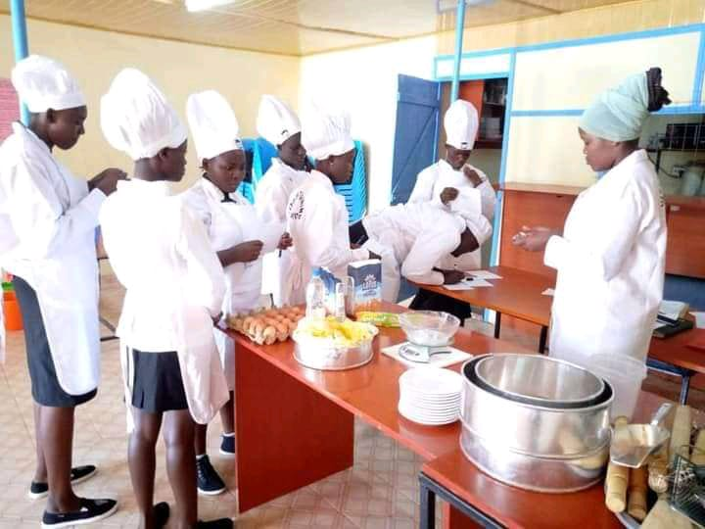
DEMONSTRATION
Demonstration means any planned performance of an occupation skill, scientific principle or experiment.
A method of instruction where the instructor performing an operation or doing a job shows the learners what to do, how to do it, and through explanations brings out why, where, and when it is done.

Slide 9

GUEST SPEAKER
Guest Speakers could be Professionals, government officials or community leaders. They add a unique perspective and life experience, provide an expert opinion, have real life experiences, to the workshop.
Having an outside expert speak to the participants, stimulates both trainer and participants.
Gives the facilitator a break from presenting, and provides an opportunity to observe the participants and their reaction to the Guest speaker.

Slide 10
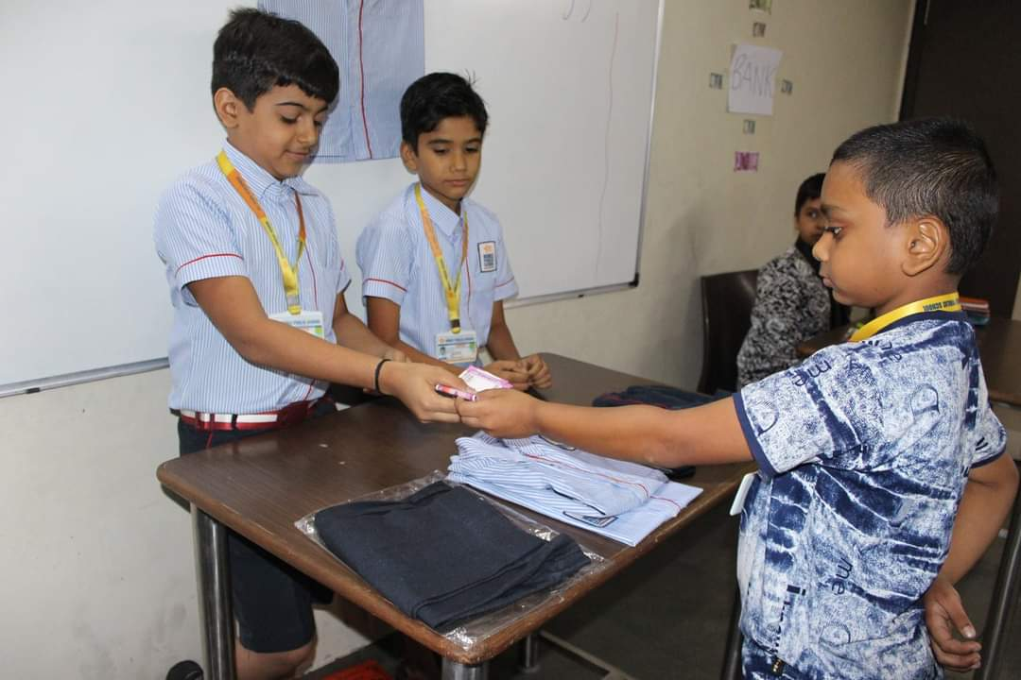
ROLE-PLAY
Learners are presented with a situation they are expected to explore by acting out the roles of those represented in this situation.
The role-play learners should be carefully selected and should be properly prepared for their roles.
The remaining learners should be equally prepared for the role-play by briefing them on how they are to act during the role-play presentation.
The players should try to behave naturally during the role-play presentation.

Slide 11

GUIDED DISCOVERY
This helps learners to personalize the concepts under study.
creating an understanding that cannot be matched using any other method of instruction.
The teacher must guide the learners toward the discovery.
This can be accomplished by providing appropriate materials, a conducive environment, and allotting time for learners to discover.

Slide 12

FIELD TRIP /STUDY TOUR
This involves learners going out to the field to learn.
The Instructor should:
Brief the learners on the details of the trip they are to make stating location, time, purpose/outcomes and expectations.
Develop a list of questions and requirements
Encourage other staff to accompany the learners.
Have a follow up to discuss and critique the trip.

Slide 13
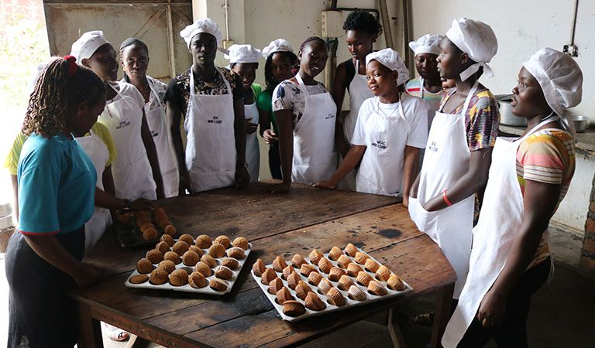
FIELD ATTACHMENT
An important component of teaching
It requires participants to get attached to organizations working on task being learnt or business issues.

Slide 14

TRANSECT
This is similar to field trips where participants are instructed and coordinated by their teacher to start from the same point to take different directions.
Participants observe and note characteristics of environment such as population, businesses operating, social infrastructure, social services available, etc.
The participants come back using the same routes to where they started and then report.
observations that can be turned into opportunities or that illustrate gaps operation in the market that they can then create enterprises to fill for example a school, car park, clinic, restaurant, etc.

Slide 15
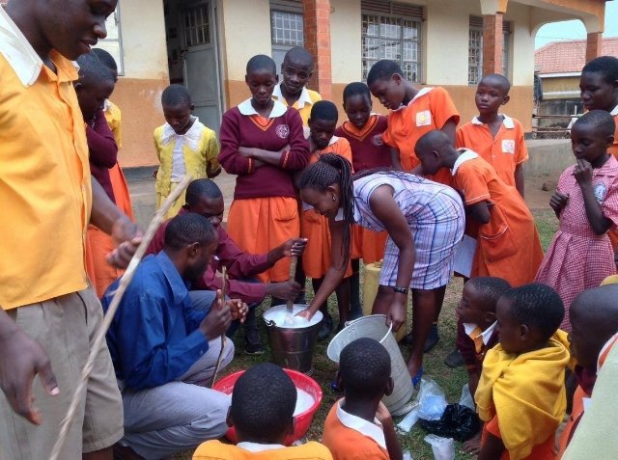
Factors that determine the choice of the Teaching-learning methodologies
Instructional competences. For example, if the competences need the student to make soap, then the teaching-learning methods should be experimental and demonstration.
Availability of teaching and learning aids. Example, if the teacher uses a model of a restaurant the method could be demonstration, observation and group discussion.
The age and interest of learners. For example, teenagers are much interested with experimentation and demonstration while lecturing bores them.

Slide 16

Factors that determine the choice of the Teaching-learning methodologies
The size of the class . for example, large numbers affect classroom control and mobility of the teacher and learners.
Time. Learner centered methods require more time and therefore when there is less time they may be difficult to use.
The learners ‘ characteristics. The teaching- learning methodology should take care of all the abilities of the learners.
The content. The method you choose should be one that can enable the teacher in ensuring that content is well delivered to the learners.

Slide 17
TECHNIQUES TO TEACH NEW CURRICULUM IN ENTREPRENUERSHIP LOWER SECONDARY SCHOOL.
Using simplified reading materials. This can be done through getting a syllabus book and teacher’s guide and other resourceful reading materials in order to get detailed and well researched content. NOTE; some teachers have a tendency to only stick on the points in the reference books, that’s very dangerous. These reference books are designed simply to give you a guidance and direction to take.
Integrating old content in the new content of new curriculum
Some teachers have completely dropped out the content, that’s wrong some is still relevant For example; Quality maintenance under production.
This is because you cannot manage and carryout production without observing quality .

Slide 18
TECHNIQUES TO TEACH NEW CURRICULUM IN ENTREPRENUERSHIP LOWER SECONDARY SCHOOL.
Avoid duplicating content. Some content has been duplicated, you can have it once in one respective topic and class instead of splitting it. The issue is all about covering it. For example instead of splitting taxation since form one you can cover it once in form two.
Instead of covering market survey in form one you can have it once in form two under marketing management. There is also budgeting under form one, you can give this a hold and present it once when teaching business planning in form three (3).
Try to use local examples which learners are familiar with. E.g. When teaching them innovation and you want to give them an example of innovation, tell them some bakers make bread but using different flavors and shapes e.g. Egg flavor, vanilla flavor, oval shape, circle shape etc. and that is innovation
When teaching them E-business you can talk about using ATM as an example of E-Banking which is a form of E-Business, online shopping e.g. Jumia Uganda, Jiji Uganda.

Slide 19
TECHNIQUES TO TEACH NEW CURRICULUM IN ENTREPRENUERSHIP LOWER SECONDARY SCHOOL.
Using videos and images through integrating ICT. This can be supported by using projectors. This makes learning very interesting, supports wide coverage, makes learning real and less tiresome to both learners and teachers
Engaging learners in learning or teaching process. Let your teaching be learner’s centered. Leave them to raise their ideas you will get shocked after realizing that they are knowledgeable and informed. They just need support.
Do not leave learners a task of generating all information on their own. They need to be supported. This is because some learners cannot access support materials for research. Such as. Internet, Newspapers, library etc. therefore supplement their research by giving items like well researched notes.
Always give these learners tasks or assignments and activities in groups. This will give them an opportunity to brain storm.

Slide 20
TECHNIQUES TO TEACH NEW CURRICULUM IN ENTREPRENUERSHIP LOWER SECONDARY SCHOOL.
Always teach from the simplest to the complex. Start with some topics which learners can easily grasp and understand. For example instead of starting with creativity in senior one, you can start with business risks because that one learners can easily relate it with their day to day life experience being in form one and later creativity can come in .
Always set questions that can test critical thinking. Avoid knowledge based questions. E.g. It has been observed that there is great poor performance of saccos in your community. Analyze the possible causes of such poor performance:
Taking learners to the field to relate the theory with practical. This makes learning relevant in the day to day life experience.
Ensuring timely completion of the syllabus coverage to create enough time for discussion and content consolidation.

Slide 21
END OF PRESENTATION.
THANK YOU.

